Slide 1

Presentation
Feedback - User Experience
Izegem
City administration
Jeffrey Bostoen

Slide 2
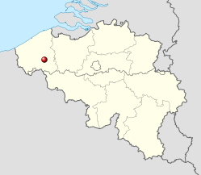
My employer
Small city (28.000+ inhabitants)
Small IT-team (3 people)
Roughly 200 staff members
About 100 administrative staff members
About 100 technical staff members

Slide 3

My employer
Mostly known for shoes and brooms

Slide 4
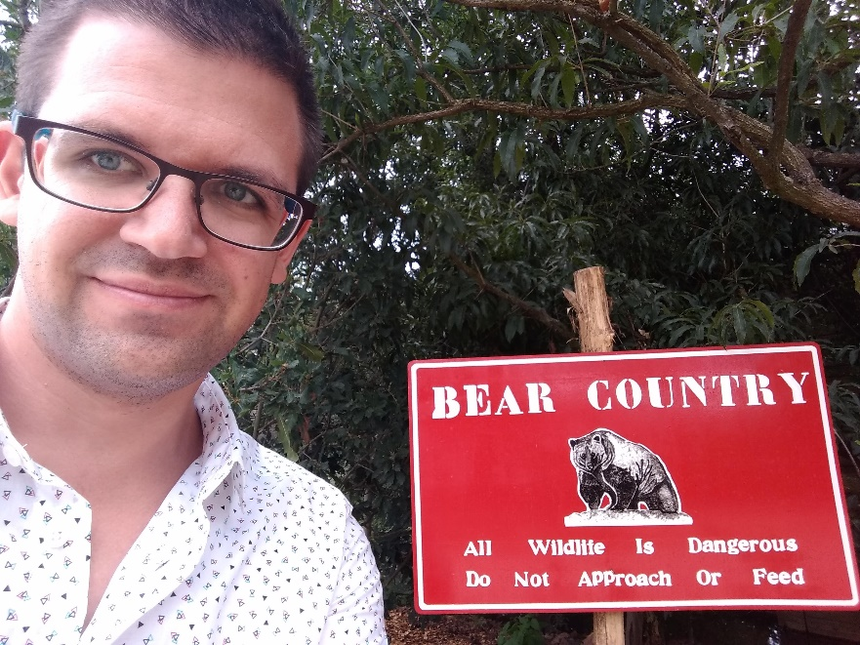
Me
IT enthusiast
In varying degrees: sysadmin, developer, analyst, user educator, first/last line support, the guy who turns things off and on again
Mostly self taught
(graduated as a teacher)

Slide 5
Me
iTop contributor
Updated Dutch translations
Reported bugs, as detailed as possible, contributed small bug fixes
Shared some ideas
Active on forum
Not just asking questions
Also trying to help others
...

Slide 6
iTop customer?
We’re not a “real” customer
We did buy some extensions and will buy more in the future.
However: we try to contribute as much as possible in return
Understand: if you don’t have the skills; definitely contact Combodo (or international partner) to discuss opportunities and paid support.

Slide 7
Our issue
Situation 2015
IT team of 2 people; colleague left
No formal helpdesk
Phone, in person, rarely by mail
Staff shattered over different locations
Remote people didn’t want to bother us that much
“Now since you’re here”....
They were in favor of a helpdesk!
Management wanted a helpdesk system
Continuity?
Checking up / reporting?

Slide 8
Our issue
Which helpdesk system?
The easy/lazy way: go with the first vendor (they were calling us anyway!)
Very popular nowadays in Flemish and Dutch municipalities
But ...

Slide 9



Our issue as local government
Future

Slide 10
Our issue
Which helpdesk system?
The other popular software product was:
Expensive
Not open source
Not flexible
No existing integrations back then
It did have a basic API
So: lazy way

Slide 11

Our issue

Slide 12
Our issue
Which helpdesk system?
The (slightly) harder way:
Do some research
Think about what you need
Don’t just copy colleagues
Don’t let vendors push you

Slide 13
The answer provided by iTop
At that very moment
Open source
Free community edition
Has most features, essential extensions are free
Send email reply
Process incoming emails
- Kind of hard at first (delivery model even for internal helpdesk. Top question at forums!)
+ Excellent documentation Discussion board does not get ignored by Combodo!

Slide 14
Helpdesk guidelines
Making people used to the helpdesk system
Communicate: why is it implemented?
Internal documentation/knowledgebase
Team = multiple people; faster service (meeting? Holidays? ...)
Be strict in guidelines and treat everyone in the same way.

Slide 15
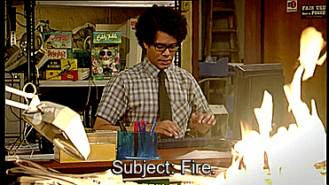
Our guidelines
Urgent? Call.
Can’t work at all
Citizen in front of user
Not urgent? Mail.
Even if people call, make them mail instead and DO NOT solve it.

Slide 16

Helpdesk guidelines
Who knows this guy?

Slide 17
Our guidelines
“Anyone at Tesla can and should email/talk to anyone else according to what they think is the fastest way to solve a problem for the benefit of the whole company. You can talk to your manager's manager without his permission, you can talk directly to a VP in another dept, you can talk to me, you can talk to anyone without anyone else's permission.”
No CC!
No other people in between → direct communication
Also, CC: is problematic when people start replying to the first/original email => creates new Ticket per e-mail *

Slide 18
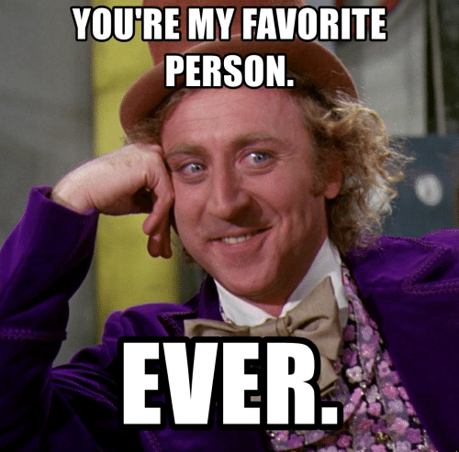

Helpdesk guidelines

Slide 19
Helpdesk guidelines
Callers have (least) favorite agents. Agents have (least) favorite callers. Callers like to ...
Send personal emails (instead of helpdesk) → bounce.
Problems usually last longer if agent is absent/busy.
Registration of the problem takes more time or doesn’t happen
Like to start emails to (our) shared helpdesk with “Hey Jeffrey!”
The helpdesk team should assign tickets to agents (and do so fairly). Don’t let the caller do so, in most cases it doesn’t matter
(unless there is some prior history)

Slide 20
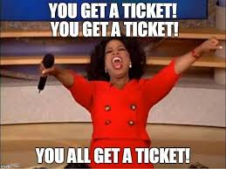
Our guidelines

Slide 21
The answer provided by iTop
Shortly after
Inventory
Functional CIs (configuration items)
Mainly for insurance
Started with new purchases
Documents
Financial department keeps asking some info every year ( inefficient; “but this way people check their contracts” - supposedly)
Some things were missing... But hey, Monitor class is an example! → Simple XML extension
Started adding more things.

Slide 22
The answer provided by iTop
Shortly after
Forked Mail to Ticket extension
Bounce annoying CC:-mails automatically + some other features
Also informed Combodo about a few possible improvements
→ First experiences with PHP development for iTop

Slide 23
The answer provided by iTop
A bit later
New young colleague
One of the remote departments wanted to have a ticket system
Modified/simplified version of iTop (second instance)
Also started creating other new classes (XML editing)
This allowed us to have:
development/test instances for all our customizations (local PC)
“test” environment for new iTop versions (our iTop for IT)
“production” environment if new iTop version and/or customizations seem fine

Slide 24
The answer provided by iTop
Local PC Jelle
iTop IT department
iTop Other departments
Local PC Jeffrey
Development Features Extensions
Production Kind of ‘fast release’ iTop 2.x.0
Production Slow release iTop 2.x.1

Slide 25
The answer provided by iTop
Even more departments followed!
IT
Culture / Events (helpdesk for their software program – ‘superusers’)
Communication (keeping track of work)
Technical services (inventory car park)
Human resources (service desk)
Building permits (service desk)
Contract management (inventory)
Technical services (service desk – issues public infrastructure) (savings!)
Social services (leisure pass)
Financial department (leisure pass – financial follow up)
...

Slide 26

The answer provided by iTop
Even more departments followed!
Variable success.
Some people
don’t like ticket systems
are “too busy”
not realizing investing time saves time
not realizing efficiency can be improved
are scared it will be used against them
Most people were very satisfied and wanted more!

Slide 27
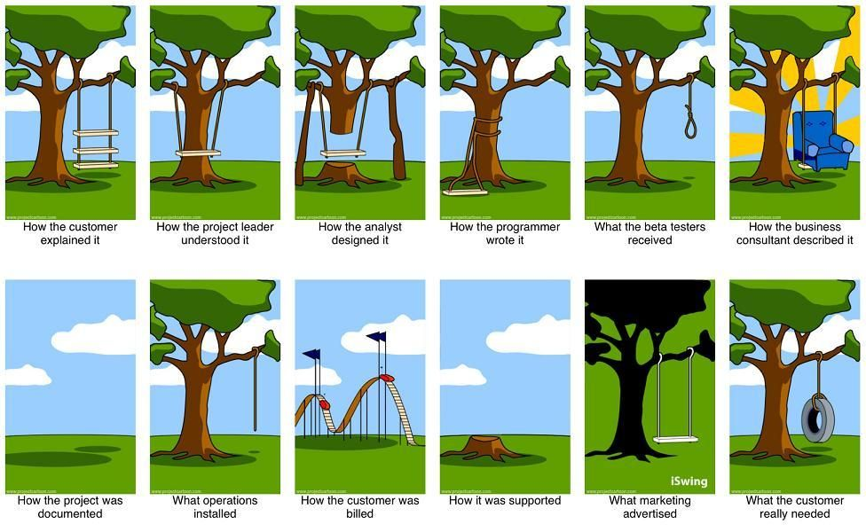
Customizing for other departments

Slide 28
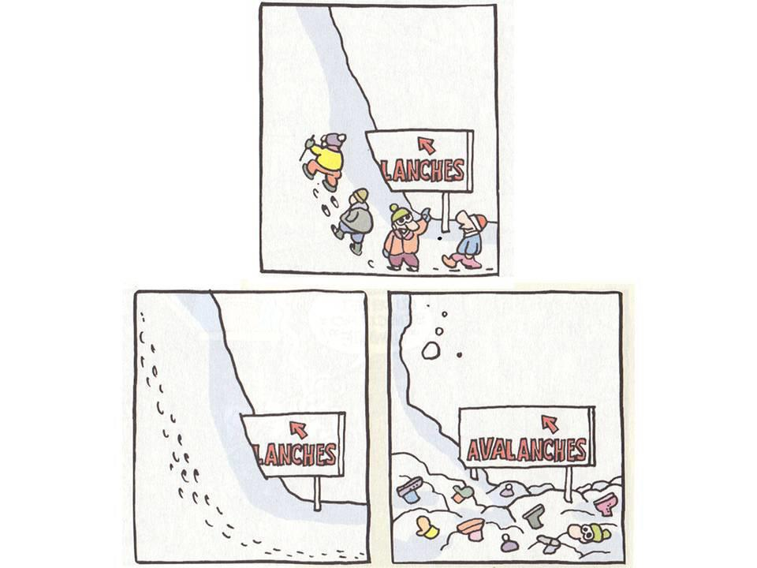
Works inspiring!
Initially some questions/concerns why a helpdesk was implemented
We used iTop
People started hearing this
More people started using iTop
People now suggest iTop as possible solution
People come up with new ideas for us to! ( feature requests )

Slide 29
We improved, too
Skill set
Better insight in iTop
Using iTop toolkit (interesting tool!)
Starting to use new tools (GitHub!)
Created a few scripts to speed things up (automated install)
...
Great resource: iTop Hub / Wiki https://www.itophub.io/wiki/page?id=latest%3Acustomization%3Axml_reference

Slide 30
Not a coder? Don’t worry!
For people with better budgets: Take a look at Combodo’s ITSM Designer!
Graphical tool

Slide 31
Custom features
NOT out of the box, but to demonstrate how flexible iTop is!
Generic
Custom version of Mail to Ticket Automation
Geometry extension
Report extension
Ticket merging
Specific
Synchronizes list of all addresses within the city (Flemish open data)
Opening mapping applications at certain coordinates
Specific integrations
…

Slide 32
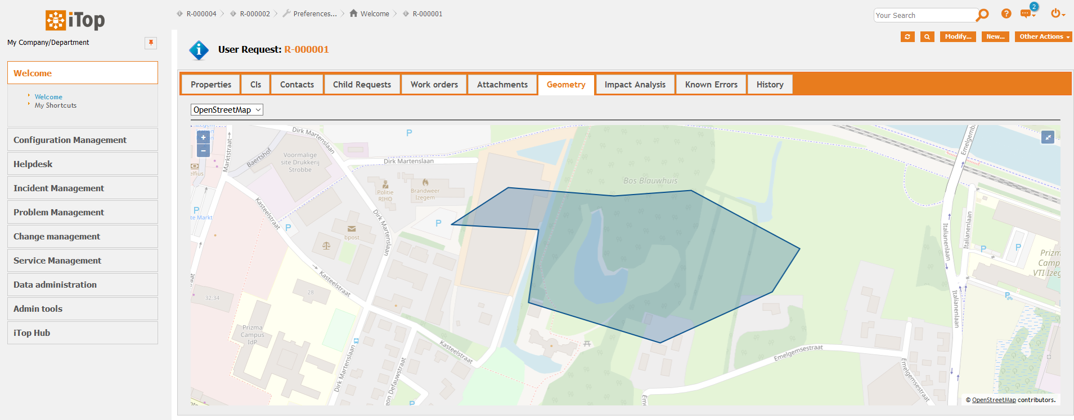
Demo: geometry extension

Slide 33
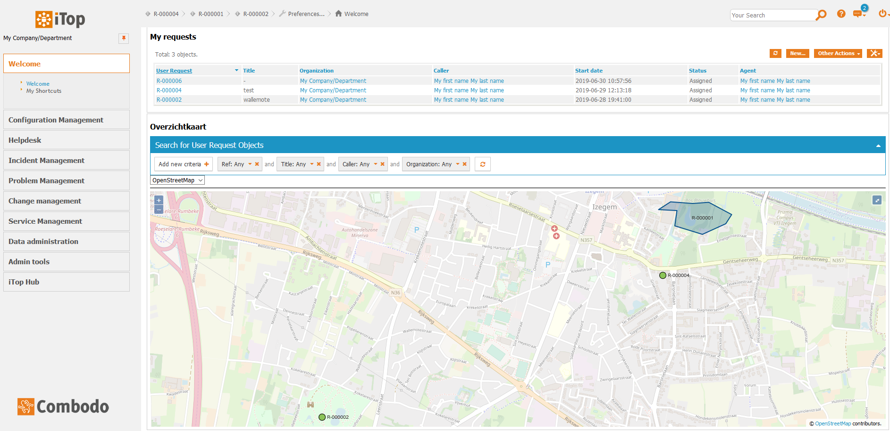
Demo: geometry extension

Slide 34
Geometry extension
One feature (Point, Line, Polygon) per iTop object
Map can be customized
Type of feature can be restricted
Coordinate system can be chosen
Clustering features
Copy as GeoJSON
Fullscreen
Dashlet: “hacked” to re-use iTop’s search feature
...

Slide 35
Report extension
Reports available as
“other actions” menu item or button
button in Details/List view
Can use all information of object(s)
Can use info from currently logged in user (“delivered by …”)
Can use iTop translations
Twig based (like new iTop Portal)
some basic calculations etc. (Twig-based)
some internationalization (date formats!) (“i18n”)
some features (QR-codes!)
…
WIP: interfaces (report to PDF, create XML, put it in folder, ...)

Slide 36
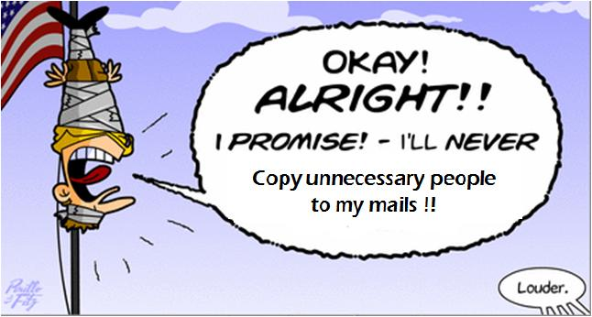
Merge tickets
Users reply/forward instantly
Pesky CC!
“Oh my problem is already solved after I thought for myself for a brief second”
Hey here’s some additional info!
Hey here’s a reminder!

Slide 37
Merge tickets
Merges ticket info
Can add all callers to “related contacts” → notifications to everyone
Can apply stimulus (resolve, close)
Can delete tickets
Options to determine which info is ...
Allowed to be merge (checkboxes)
Merged by default (selected)
Must be merged (selected + can’t be unchecked)
Custom triggers
Running on source tickets (inform people their ticket will be merged; different ticket ref.)
Running on target ticket (inform caller people have been added to CC: )
Known issue: “on object update” trigger should be avoided

Slide 38
ActionRest
Haven’t used this myself a lot yet ☺
Brief concept of a notification/action which can post iTop data to any external program

Slide 39
Custom portals / front ends
Report problems
https://meldingen.izegem.be
Actually stopped using another (horrible) program! Savings! To be re-invested (in iTop)
Citizen participation
https://zegheteens.izegem.be
Project information
???
Inventory Check-out
Scanning, QR-codes

Slide 40
Benefits
“service” desk rather than “help” desk
Much broader than IT (should be advertised more ☺ )
iTop in the back end; front end adjusted → highly customizable!
(no) licensing costs
REST/JSON API
Front ends
PowerShell
...
We can contribute (translations, ideas, bug reports, ...)!

Slide 41
Limitations
rights management is complicated; not granular enough.
Example: people should have ‘write’ access to contracts of some orgs; but only ‘read’ access to contracts of other departments.
GDPR: what about limiting (common) field info? (contact information) (also a broader organizational question for us internally)
some (current) technical limitations
TeemIP: enforces unique IP-addresses; but we have multiple same IPs (although different networks) due to our remote sites. or other purposes, not interesting to make this yet another (sub)organization.
can’t define a more specific filter on a subclass
...

Slide 42
Limitations
Some other things
Most only come up when you’re really getting deep into iTop.
SELECT Something WHERE id NOT IN (SELECT SomethingElse)
Class A
class B refers (ExternalField)to attribute of class A → takes all data properly
class C refers (ExternalField) to attribute of class B which refers to class A
Works fine for most normal data
Doesn’t work (yet?) for more complicated data types (Picture -> stored in multiple columns)

Slide 43
Keep in mind
Be realistic. Combodo owns the product. It’s their (awesome) creation.
not every idea can be done with extensions
not every pull request you make gets included in the core

Slide 44
Future Projects
More extensions
LDAP, image attachment compressor, ...
More custom classes
More front ends
For citizens
Portals. Login or not? → custom framework
For staff
Technical staff on the road with smartphone/tablet; custom UI for iTop data?
Planning?
...
Personal ambitions? iTop Hub for third party developers?

Slide 45

Thank you Combodo and partners!
Great staff, open mind, friendly people!
Great product

Slide 46
Thank you all!
Contact
jbostoen@outlook.com
https://github.com/jbostoen/iTop-custom-extensions
Contains both finished things as well as work in progress
PowerShell module
Some extensions (Mail to Ticket fork, reporting, ...)
Examples of some classes
Some pointers (setting up helpdesk, ...)
Documentation on some pro extensions
...

